Slide 1

Venue App Project
Guillermo Zerpa
@Guiyed on GitHub

Slide 2
Description
VenueApp is an event ticketing Web application that allows staff members of any organization to manage and track reservations for the events they offer. It also allows consumers to browse the webpage for available events and make a reservation online.
This application could become a customizable platform for any business owner who needs to manage users, events, memberships, reservations, tickets, promotions etc.

Slide 3
Features
User Signup, Login and Logout (Through Sessions)
Embedded Administrator and User roles in the app (Allowing separate dashboards and features)
Intuitive Management of database tables (create, edit, delete)
Populate Events table via 3rd party connection (Ticketmaster API)
Query Interface to browse or search events in the database.
Events Location Map (Using BingMaps API)
Unique user reservation QR code Ticket. (Using goqr.me API)

Slide 4
Planning - User Stories
Administrators can login, create and edit events (with details such as date/time, location, title, description, category, etc.).
Administrators can populate or fill the events database with real life data via queries to an Events API.
Users can browse the web app and search for available events
Users can signup and/or login to the app which will enable them to Book an event and also manage their reservations and profile info.
Users can view their bookings and request an QR code for the event.

Slide 5
Planning - Database
The primary tables for the database are: Users, Events and Bookings. The Secondary tables are: Type, Memberships and Categories.
All tables except Bookings, have a primary key(ID).
Users have all the information of a common user, like: Username (Unique index), Full Name, Password, etc. they have a one to many relationship to the Type table, and Membership table through their foreign keys.
Events have all the information of an event, like: Name, Date, Time, Category, etc. They have a one to many relationship to Categories through the foreign key.
Bookings is a Cross-Reference table to create a many to many relationship between the users and the events. The objective is to create a unique Reservation for each user.

Slide 6
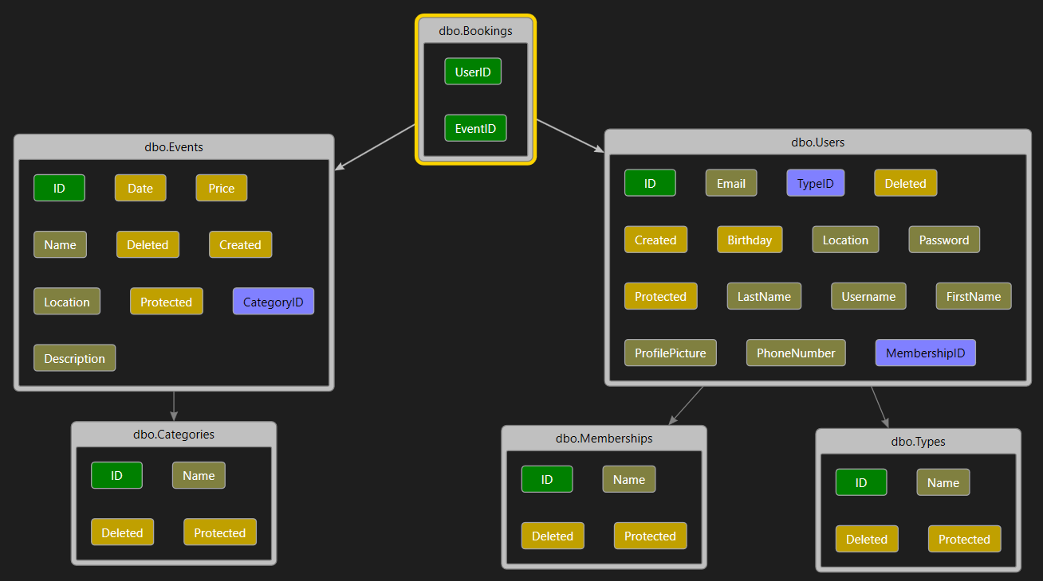
Planning - Database (continued)

Slide 7










Technology Stack
IDE: Visual Studio 2017
Language: C#
Framework: ASP.NET Core MVC
Template engine: Razor Pages
Database engine: SQL Server Database (Managed by Microsoft Entity Framework)
Front End and UI: Bootstrap, HTML and CSS
API Interactions: JavaScript and Ajax

Slide 8
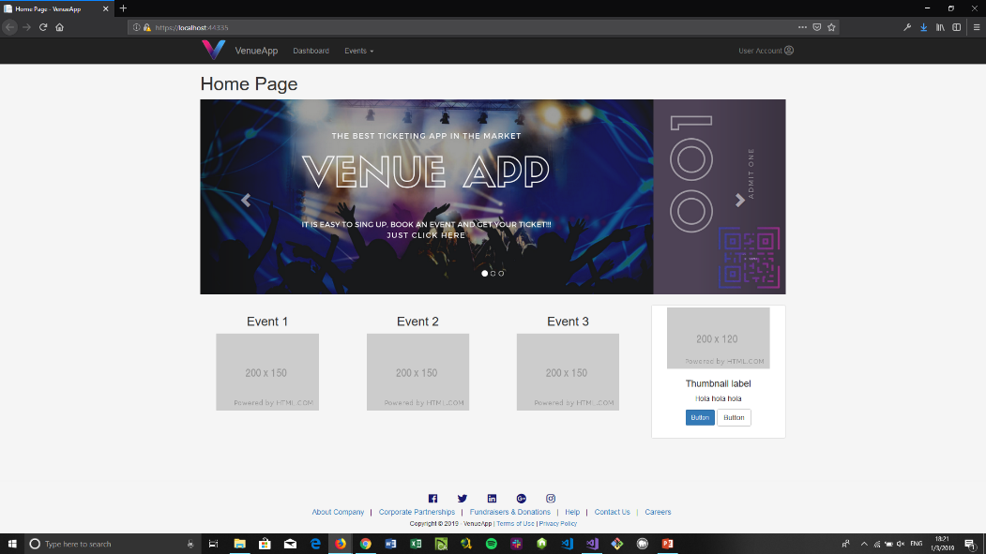
Demo (Homepage)

Slide 9
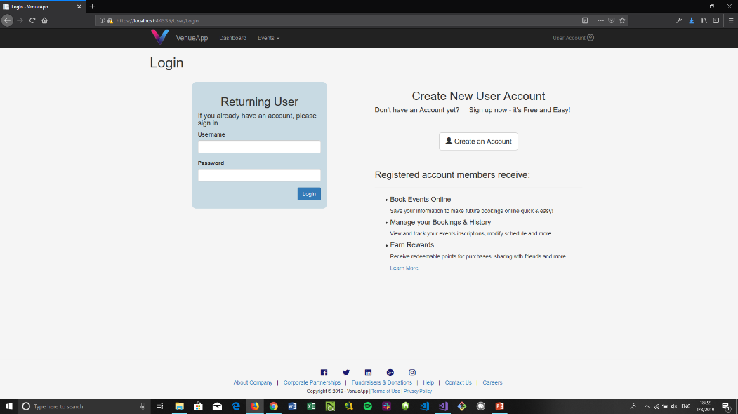
Demo (Login)

Slide 10
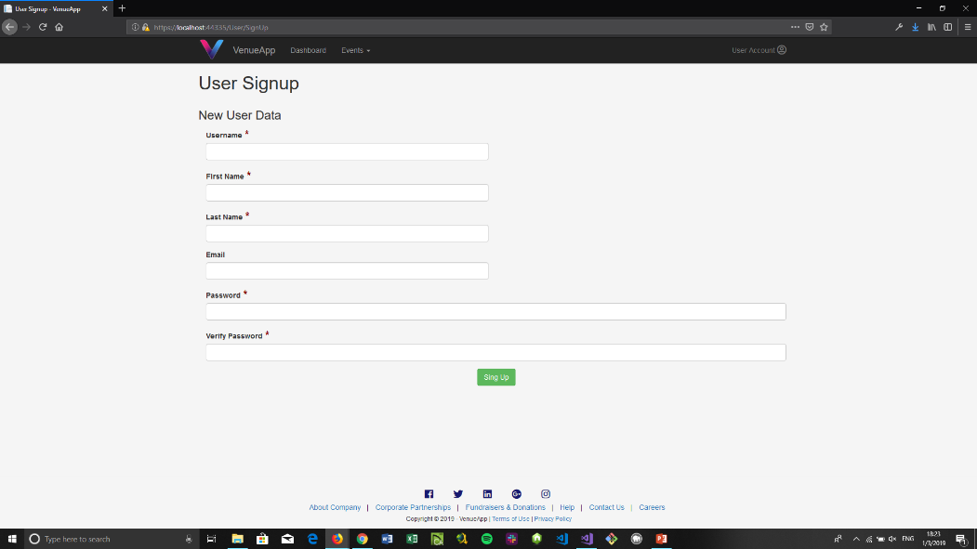
Demo (User Signup)

Slide 11
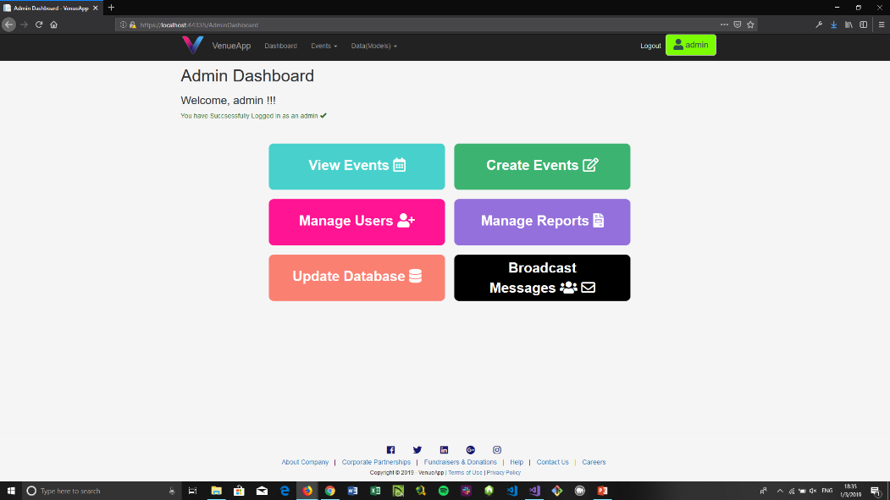
Demo (Admin Dashboard)

Slide 12
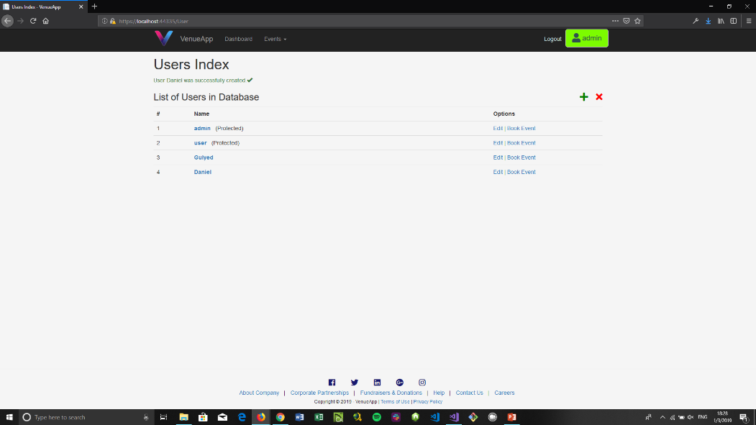
Demo (Manage Users by Admin - Index)

Slide 13
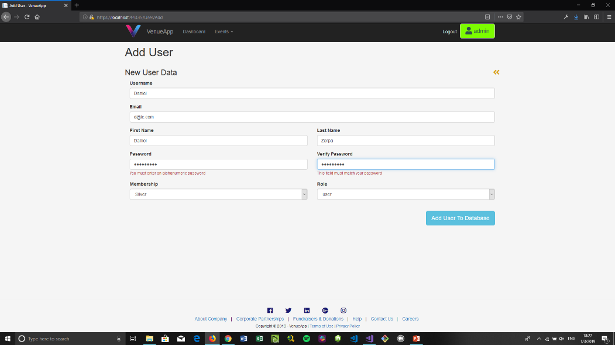
Demo (Manage Users by Admin – Add)

Slide 14
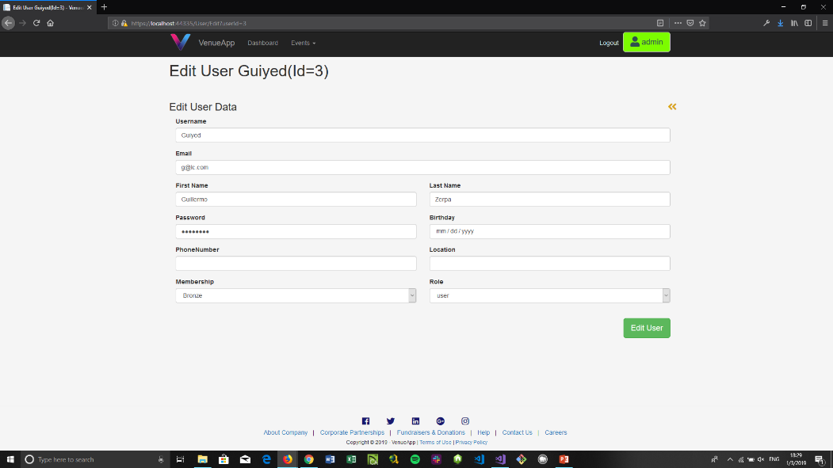
Demo (Manage Users by Admin – edit)

Slide 15
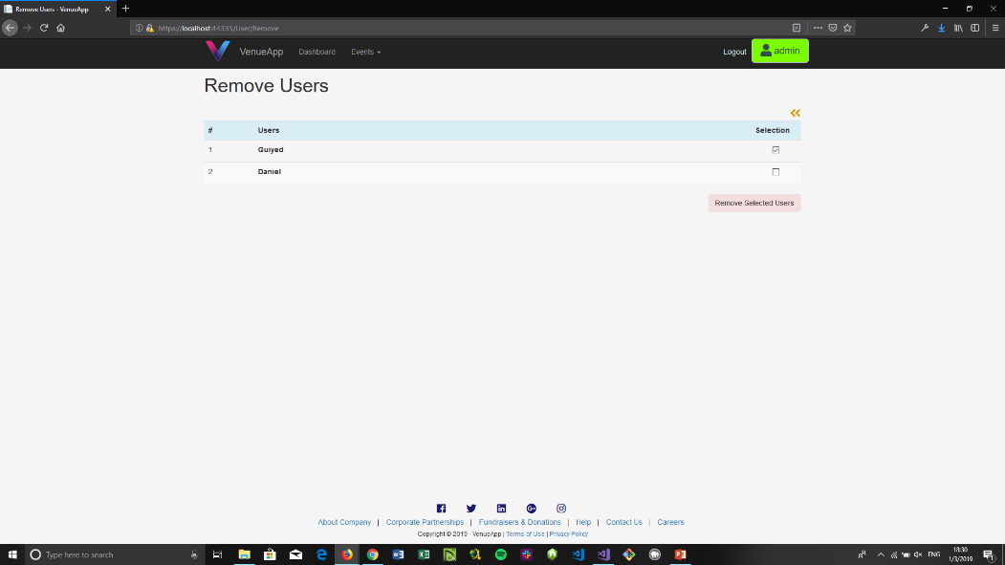
Demo (Manage Users by Admin - delete)

Slide 16
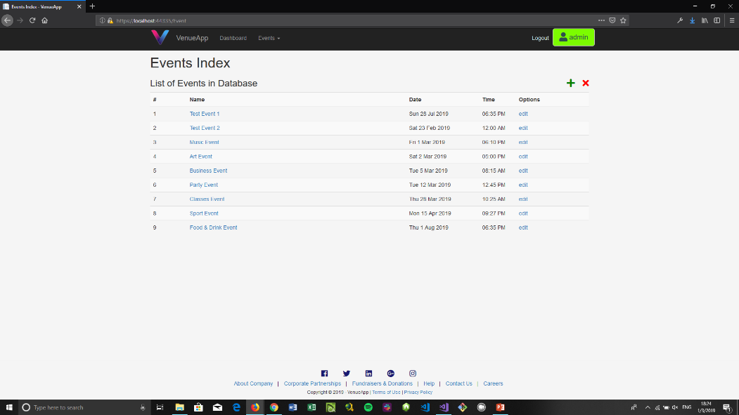
Demo (Manage Events by Admin)

Slide 17
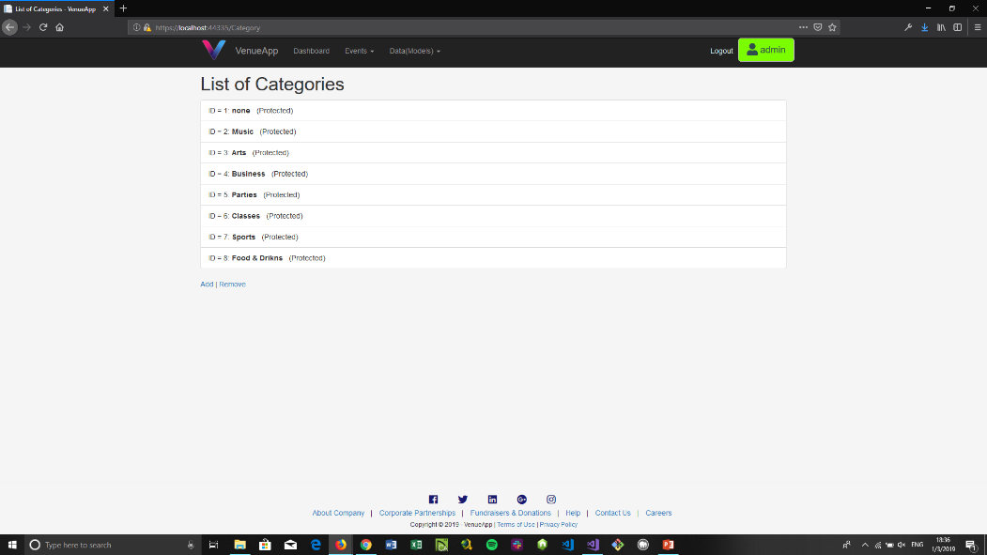
Demo (Manage Categories by Admin)

Slide 18
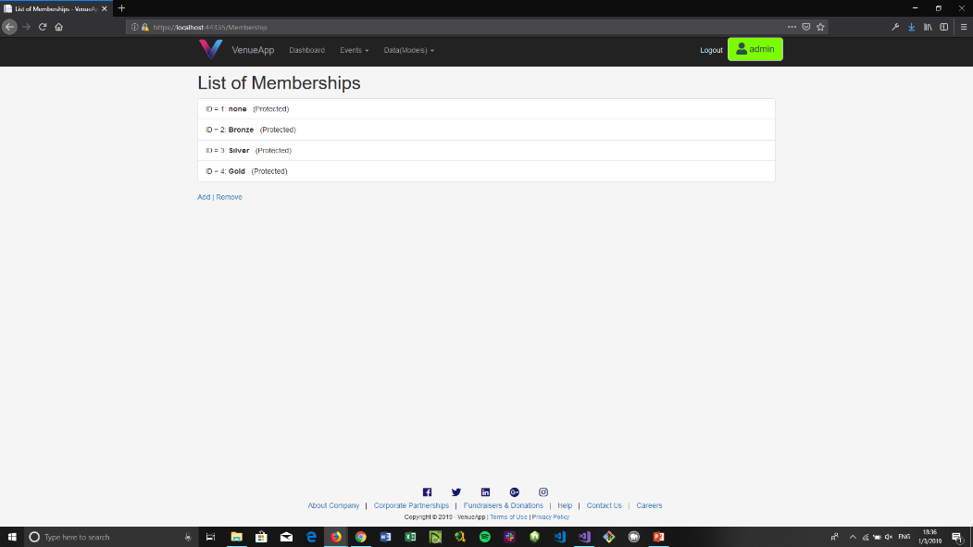
Demo (Manage Memberships by Amin)

Slide 19
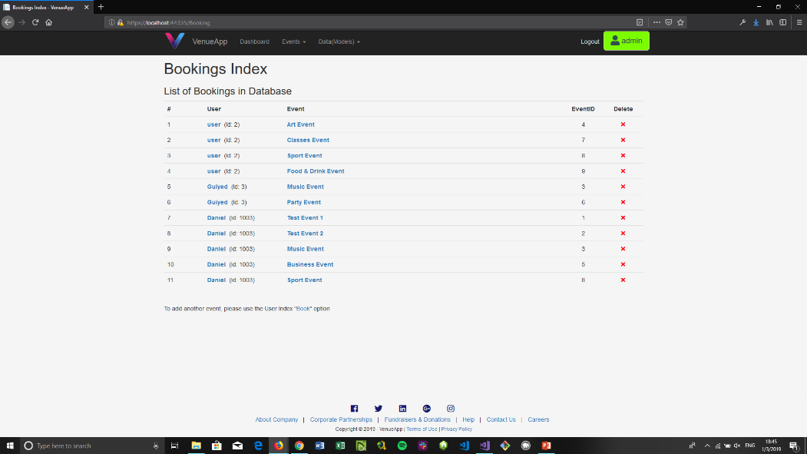
Demo (Manage Bookings by Admin)

Slide 20
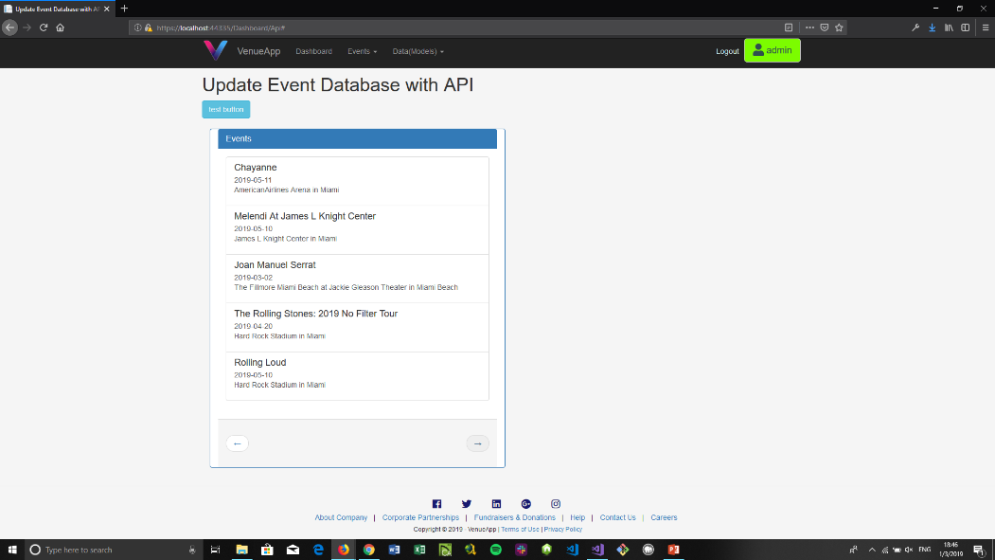
Demo (Interacting Event API - show)

Slide 21
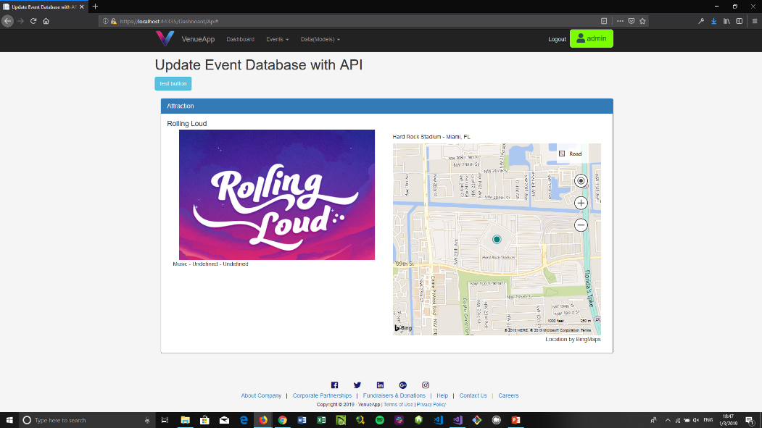
Demo (Interacting Event API - details)

Slide 22
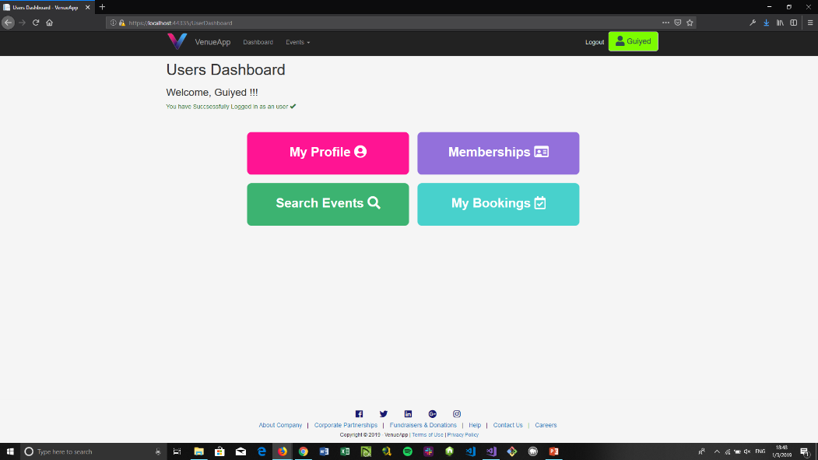
Demo (User Dashboard)

Slide 23
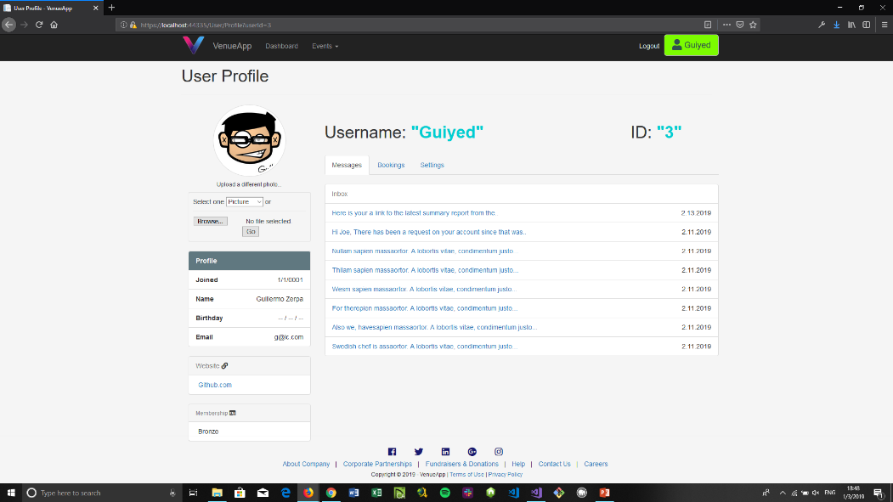
Demo (User Profile - Home)

Slide 24
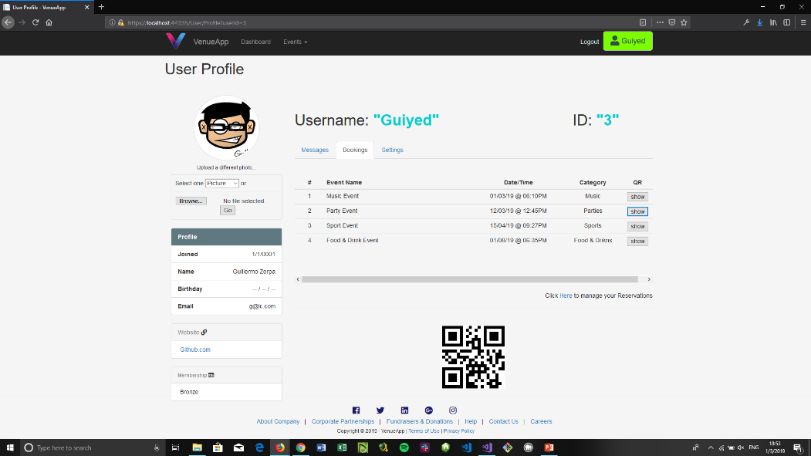
Demo (User Profile – View Bookings)

Slide 25
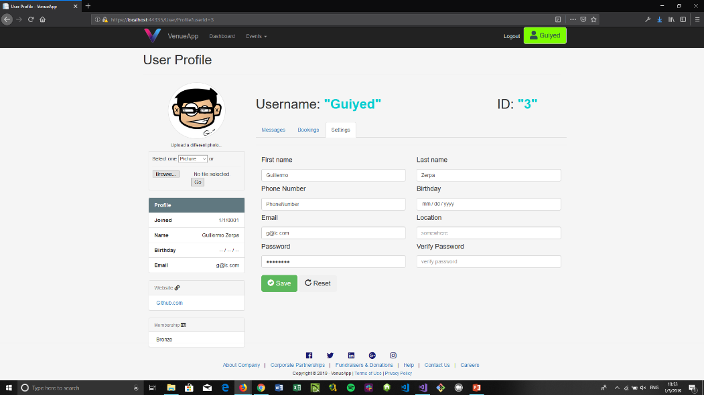
Demo (User Profile - Settings)

Slide 26
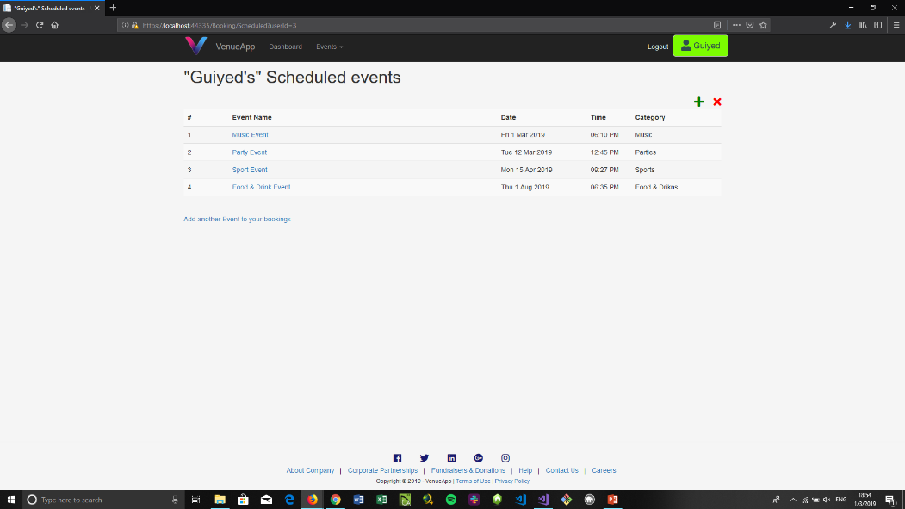
Demo (Manage Bookings by User)

Slide 27
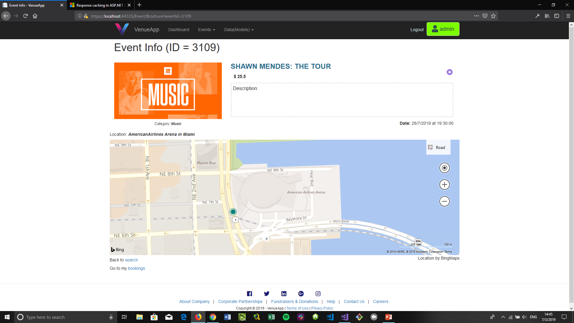
Demo (Event Brochure by User)

Slide 28
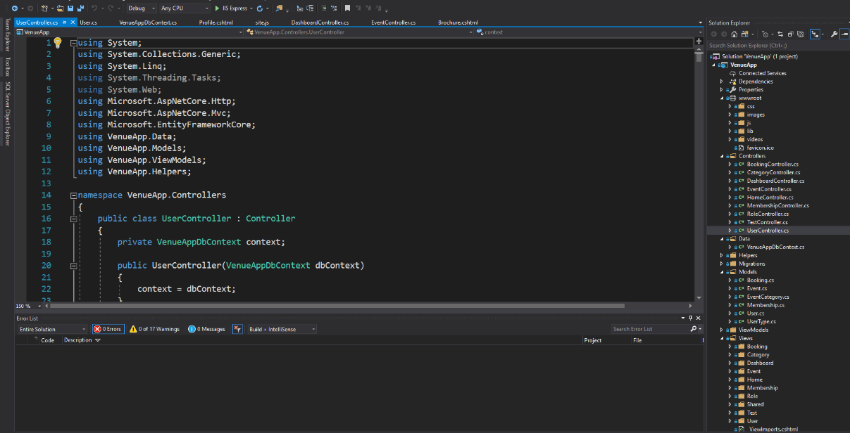
Demo (Solution Explorer)

Slide 29
What I Learned
I became more proficient reading documentation and searching information on Google.
I learn the hard way how to implement sessions and roles.
I learned how to create separate Dashboards for users and admins.
I learned how to integrate “tabs” in a single page. I used this for my profile view.
I learned some JavaScript via reverse engineering of running examples.

Slide 30
What I Learned (continued)
I learned what is an API and how to interact or connect with an API via AJAX.
I finally understood CSS and got proficient with Bootstrap 3.3.7
I learn more about GIT Branches and their benefits to use them.
I have also learned that there is always a free or almost free API for anything that you need. For example I used API’s for pictures placeholders, Events Data (with a lot of useful and updated information), Map Location and QR codes.

Slide 31
What’s Next
Deploy App on the Internet (Microsoft Azure, AmazonWebService)
Refactor the whole app (DontRepeatYourself).
Learn how to use and implement the built in Windows Security, Authentication, and Authorization Libraries.
Add Cookies and promotions.
Implement and integrate an automatic “Broadcast message” feature (using email and/or SMS) for target marketing.
Learn AngularJS and incorporate it to the project.
Notes:
Be specific! If you mention another feature describe why that features is necessary, or what problem it solves. If you mention changing the UI mention specific technologies, or libraries you will use to do that. If you mention a technology, or feature you don’t know yet tell them how you plan on learning it.

